Slide 1
Visual Odometry : Team Prestige
Amitabh Sharma• 2022702005
Priyansh Sinha• 2022701017
Saksham Gupta• 2022900038

Slide 2
Overview
Visual Odometry for tracking camera pose using Images only.
Specification:
Kitti Dataset for standardizing tests: It has a left and right image pairs for 4541 frames.
Campus stereo data.
Rgbd main lab data

Slide 3
Workflow:
Parts
Reading data
Finding and fixing global frame.
Find the disparity map
Decomposition of Projection matrix to KRT.
Find the depth, i.e 2D to 3D correspondences.
Feature Matching between consecutive frames.
From the 2D-3D correspondence find the Camera poses using PnP method.
Post processing using, Kalman filter.

Slide 4
Disparity Map
Procedure
Tries to match one point in right image with all points in the left image.
For simplicity the images are kept in the same horizontal baseline, to match the rows.
After the match, the shift required to align left and right points is the disparity.
Tools:
BM: Block matching
SGBM: Semi global Block matching.
(The rows are broken into blocks, which are compared to other blocks.)

Slide 5
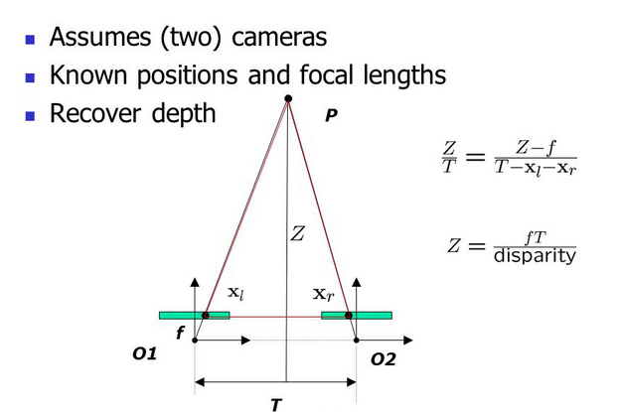
Depth from Disparity
Procedure
Now that we have disparity we can find depth(z) using z = focal length * (image center distance/ disparity). Aka: triangulation.
We pass rays from the matches to the image place. The intersection is the 3D point.
There are errors in the points due to height difference of the rays intersection.
Code level:
Projection matrix for left and right image is taken.
It is decomposed into KRT.
From K we get the focal and center of the image frame(not always center). Fx and cx cy.
Applying to the formula gets us Depth.

Slide 6
Feature Matching and estimating motion:
Procedure
Given two consecutive images, we apply feature matching algorithms.
We then compute the estimated motion of that key points.
We have 3d and 2d correspondences. We need to compute the motion in the form of R and T.
Tools:
SIFT and Orb for feature matching.
PnP for RT computation.
Light Glue DL based feature matcher

Slide 7
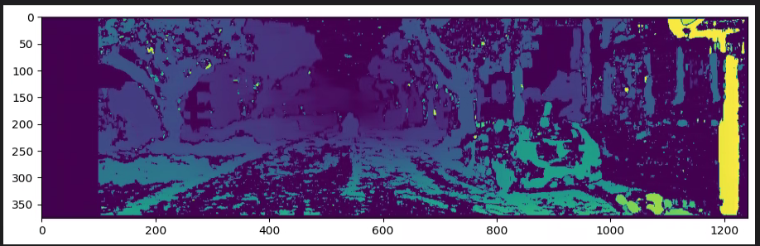
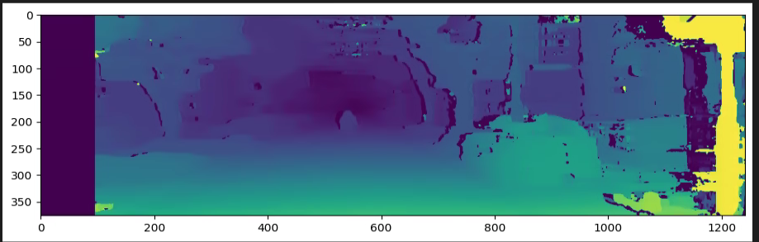
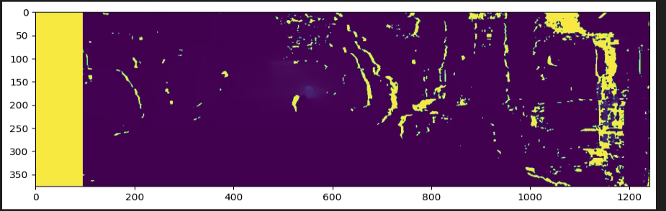
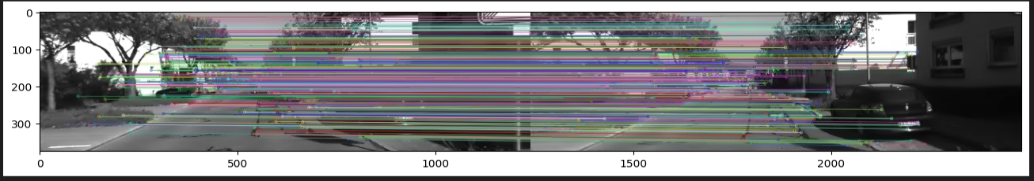
BM
SGBM
Depth Map
Matched Features

Slide 8
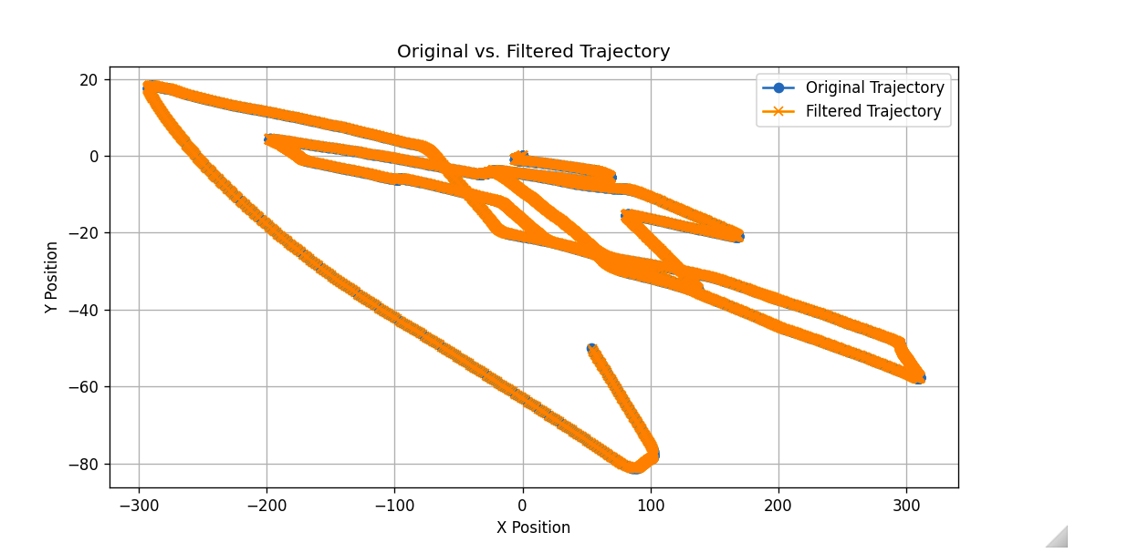
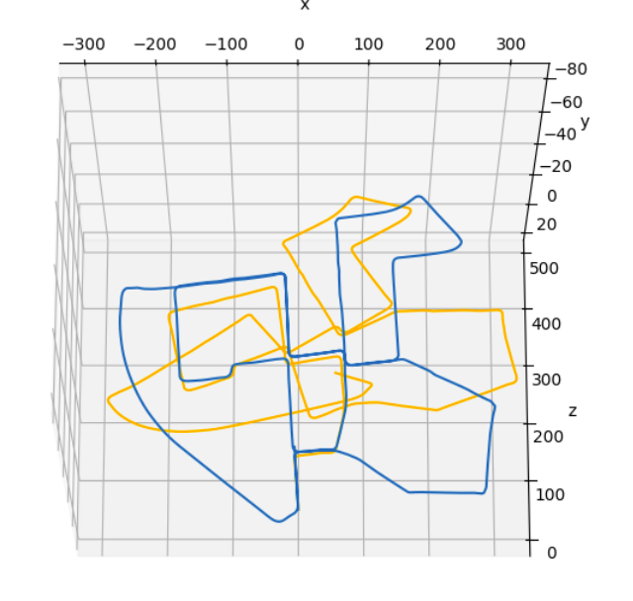
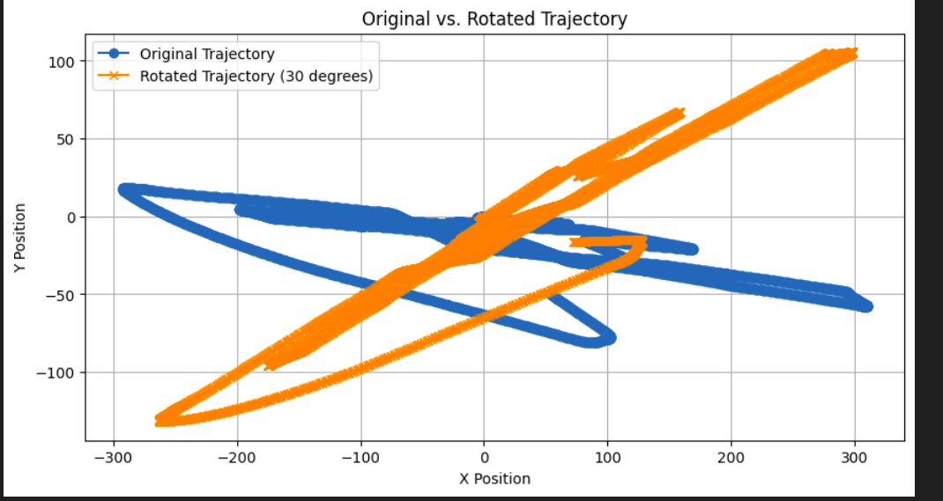
Results & Ablations:
Computed vs gt trajectory.
( SGBM with Sift, lightglue)
Kalman Filter

Slide 9
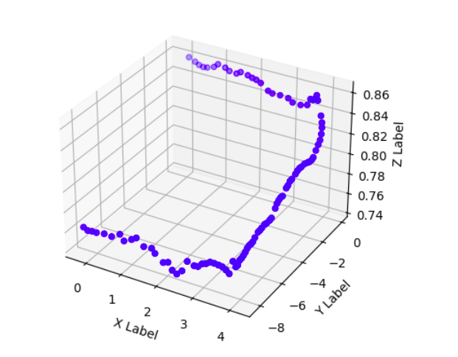
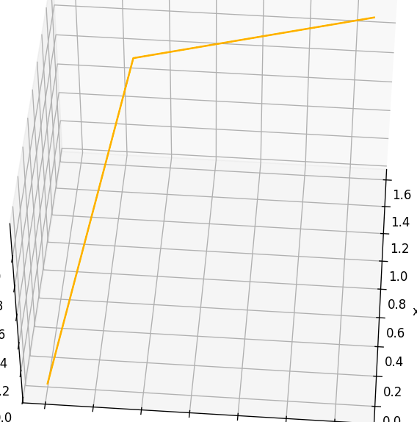
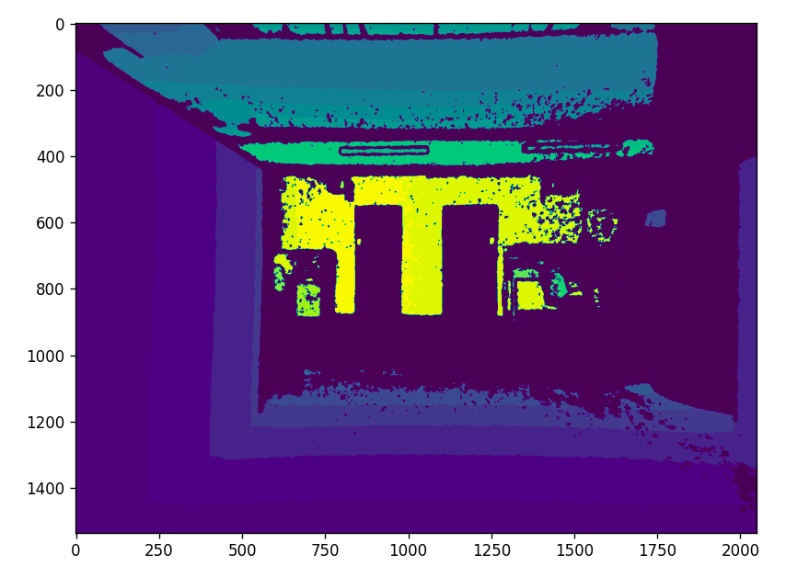
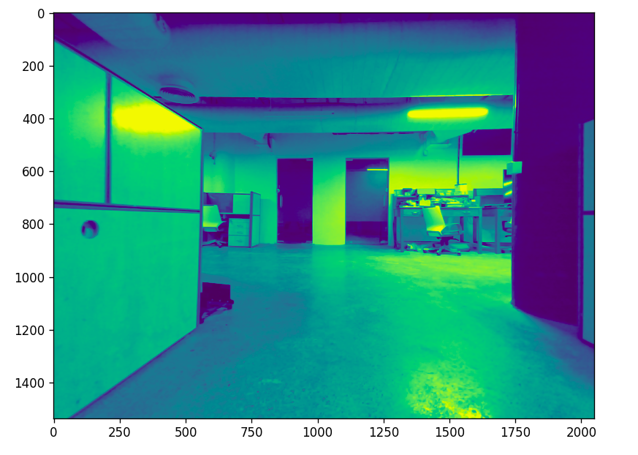
Lab RGBD Data:

Slide 10
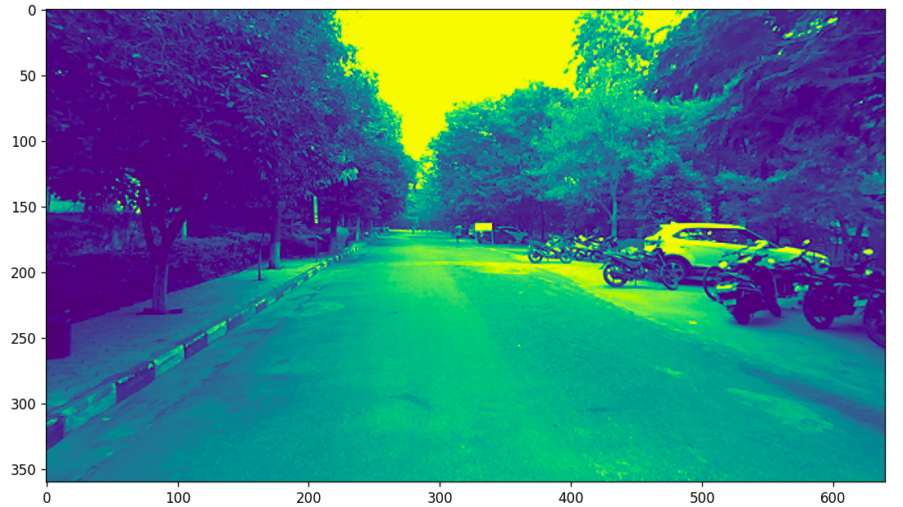
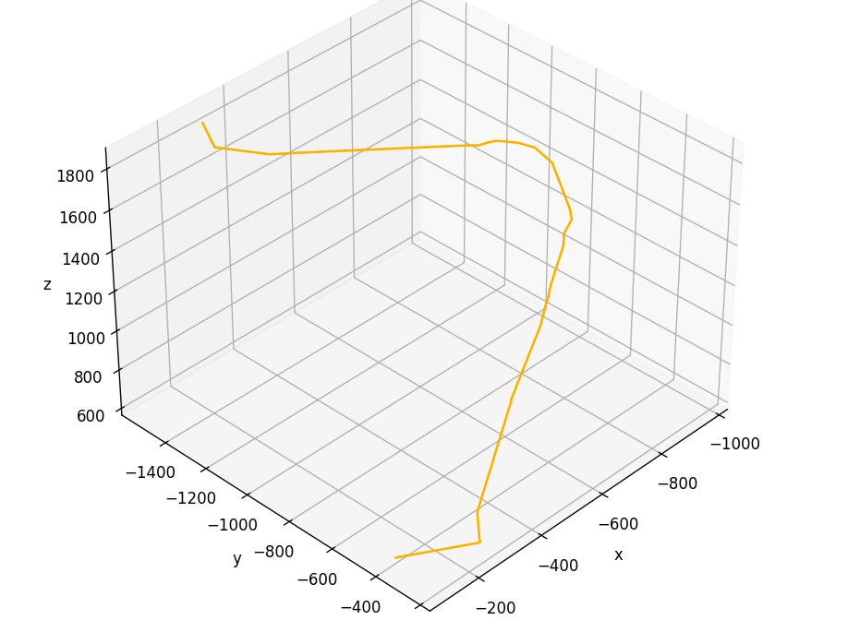
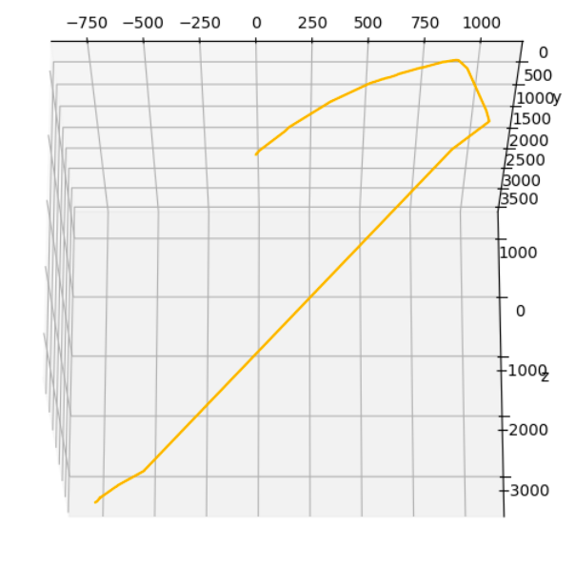
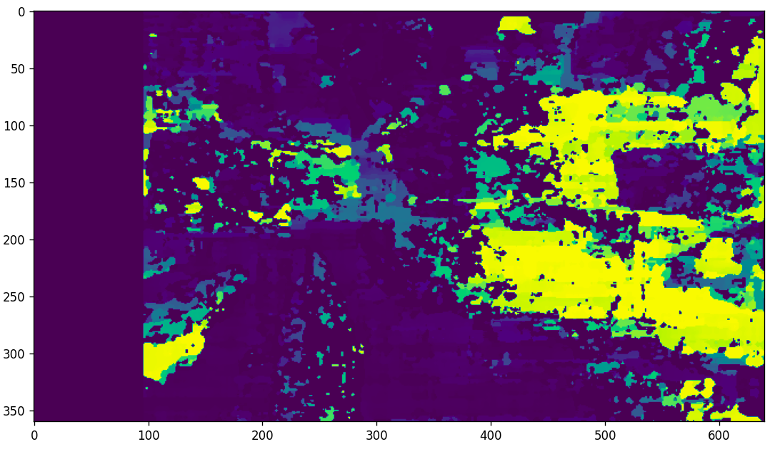
Campus stereo data:

Slide 11
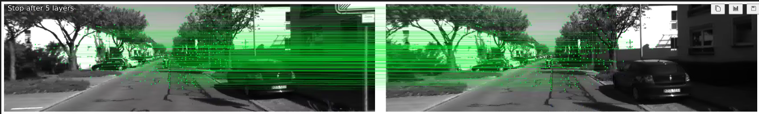
Ablations:
Tested using:
SGBM, BM for extractor
Sift, Orb, Lightglue as feature matcher
Stereo Images and RGBD images
Observation: SGBM with SIFt and Light glue gives the best estimates. Rmse: 200 for Sift and 98 for Lightglue.

Slide 12
Thank You
Dataset link: https://iiitaphyd-my.sharepoint.com/:u:/g/personal/priyansh_sinha_research_iiit_ac_in/EcGJ39mPM0ZGnwW7RPWIpcgBmmKKo-t8CQKbVKY2XEjtxQ?e=MqQjkl

